Slide 1

CHAPTER 3
THE LOGIC OF
QUANTIFIED
STATEMENTS
Copyright © Cengage Learning. All rights reserved.

Slide 2
SECTION 3.2
Predicates and Quantified Statements II
Copyright © Cengage Learning. All rights reserved.

Slide 3
Negations of Quantified Statements

Slide 4
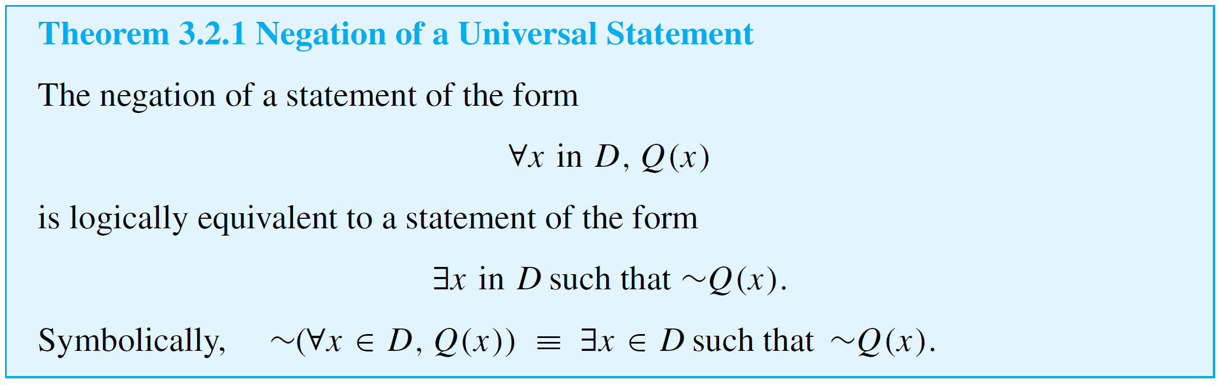
Negations of Quantified Statements
The general form of the negation of a universal statement follows immediately from the definitions of negation and of the truth values for universal and existential statements.

Slide 5
Negations of Quantified Statements
Thus
The negation of a universal statement (“all are”) is logically equivalent to an existential statement (“some are not” or “there is at least one that is not”).
Note that when we speak of logical equivalence for quantified statements, we mean that the statements always have identical truth values no matter what predicates are substituted for the predicate symbols and no matter what sets are used for the domains of the predicate variables.

Slide 6
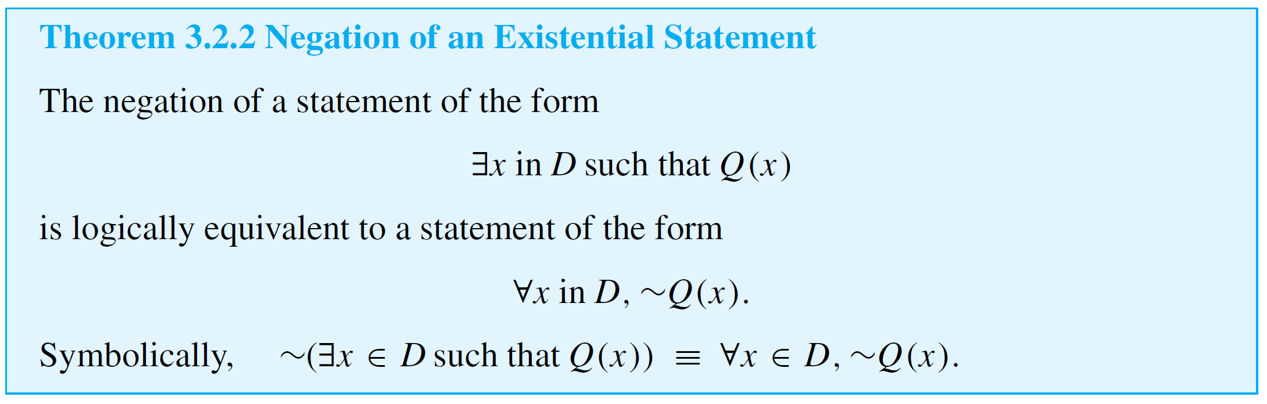
Negations of Quantified Statements
The general form for the negation of an existential statement follows immediately from the definitions of negation and of the truth values for existential and universal statements.

Slide 7
Negations of Quantified Statements
Thus
The negation of an existential statement (“some are”) is logically equivalent to a universal statement (“none are” or “all are not”).

Slide 8
Example 1 – Negating Quantified Statements
Write formal negations for the following statements:
a. ∀ primes p, p is odd.
b. ∃ a triangle T such that the sum of the angles of T
equals 200°.
Solution:
a. By applying the rule for the negation of a ∀ statement,
you can see that the answer is
∃a prime p such that p is not odd.

Slide 9
Example 1 – Solution
cont’d
b. By applying the rule for the negation of a ∃ statement,
you can see that the answer is
∀ triangles T, the sum of the angles of T does not equal 200°.

Slide 10
Negations of Universal Conditional Statements

Slide 11
Negations of Universal Conditional Statements
Negations of universal conditional statements are of special importance in mathematics.
The form of such negations can be derived from facts that have already been established.
By definition of the negation of a for all statement,
But the negation of an if-then statement is logically equivalent to an and statement. More precisely,

Slide 12

Negations of Universal Conditional Statements
Substituting (3.2.2) into (3.2.1) gives
Written less symbolically, this becomes

Slide 13
Example 4 – Negating Universal Conditional Statements
Write a formal negation for statement (a) and an informal negation for statement (b).
a. ∀ people p, if p is blond then p has blue eyes.
b. If a computer program has more than 100,000 lines,
then it contains a bug.
Solution:
a. ∃ a person p such that p is blond and p does not have
blue eyes.

Slide 14
Example 4 – Solution
cont’d
b. There is at least one computer program that has more
than 100,000 lines and does not contain a bug.

Slide 15
The Relation among ∀, ∃, ∧, and ∨

Slide 16
The Relation among ∀, ∃, ∧, and ∨
The negation of a for all statement is a there exists statement, and the negation of a there exists statement is a for all statement.
These facts are analogous to De Morgan’s laws, which state that the negation of an and statement is an or statement and that the negation of an or statement is an and statement.
This similarity is not accidental. In a sense, universal statements are generalizations of and statements, and existential statements are generalizations of or statements.

Slide 17


The Relation among ∀, ∃, ∧, and ∨
If Q(x) is a predicate and the domain D of x is the
set {x₁, x₂, . . . , x_{n}}, then the statements
and
are logically equivalent.

Slide 18


The Relation among ∀, ∃, ∧, and ∨
Similarly, if Q(x) is a predicate and D = {x₁, x₂, . . . , x_{n}}, then the statements
and
are logically equivalent.

Slide 19
Vacuous Truth of Universal Statements

Slide 20
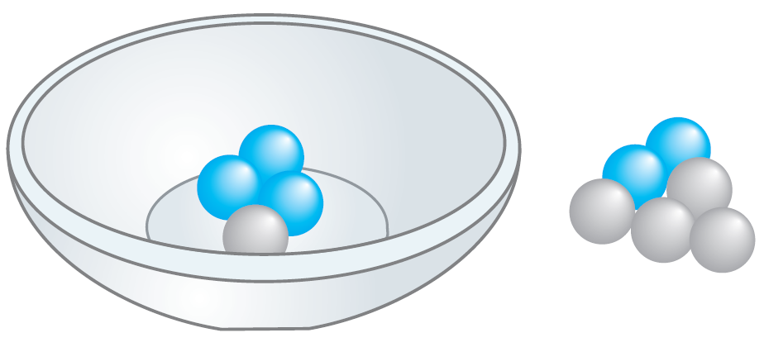
Vacuous Truth of Universal Statements
Suppose a bowl sits on a table and next to the bowl is a pile of five blue and five gray balls, any of which may be placed in the bowl.
If three blue balls and one gray ball are placed in the bowl, as shown in Figure 3.2.1(a), the statement “All the balls in the bowl are blue” would be false (since one of the balls in the bowl is gray).
Figure 3.2.1(a)

Slide 21
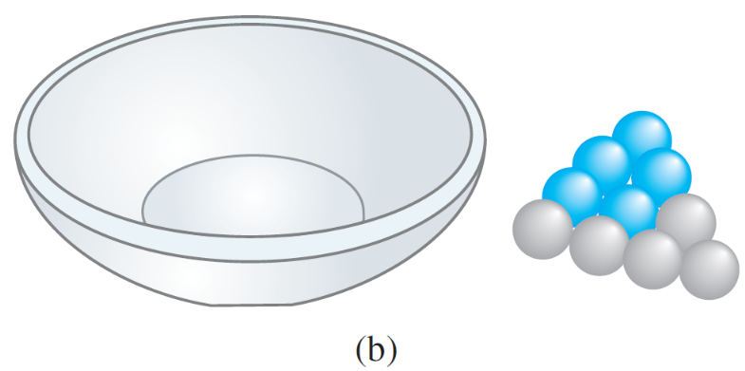
Vacuous Truth of Universal Statements
Now suppose that no balls at all are placed in the bowl, as shown in Figure 3.2.1(b).
Consider the statement
All the balls in the bowl are blue.
Figure 3.2.1(b)

Slide 22
Vacuous Truth of Universal Statements
Is this statement true or false? The statement is false if, and only if, its negation is true.
And its negation is
There exists a ball in the bowl that is not blue.
But the only way this negation can be true is for there actually to be a nonblue ball in the bowl.
And there is not! Hence the negation is false, and so the statement is true “by default.”

Slide 23

Vacuous Truth of Universal Statements
In general, a statement of the form
is called vacuously true or true by default if, and only if, P(x) is false for every x in D.

Slide 24
Variants of Universal Conditional Statements

Slide 25
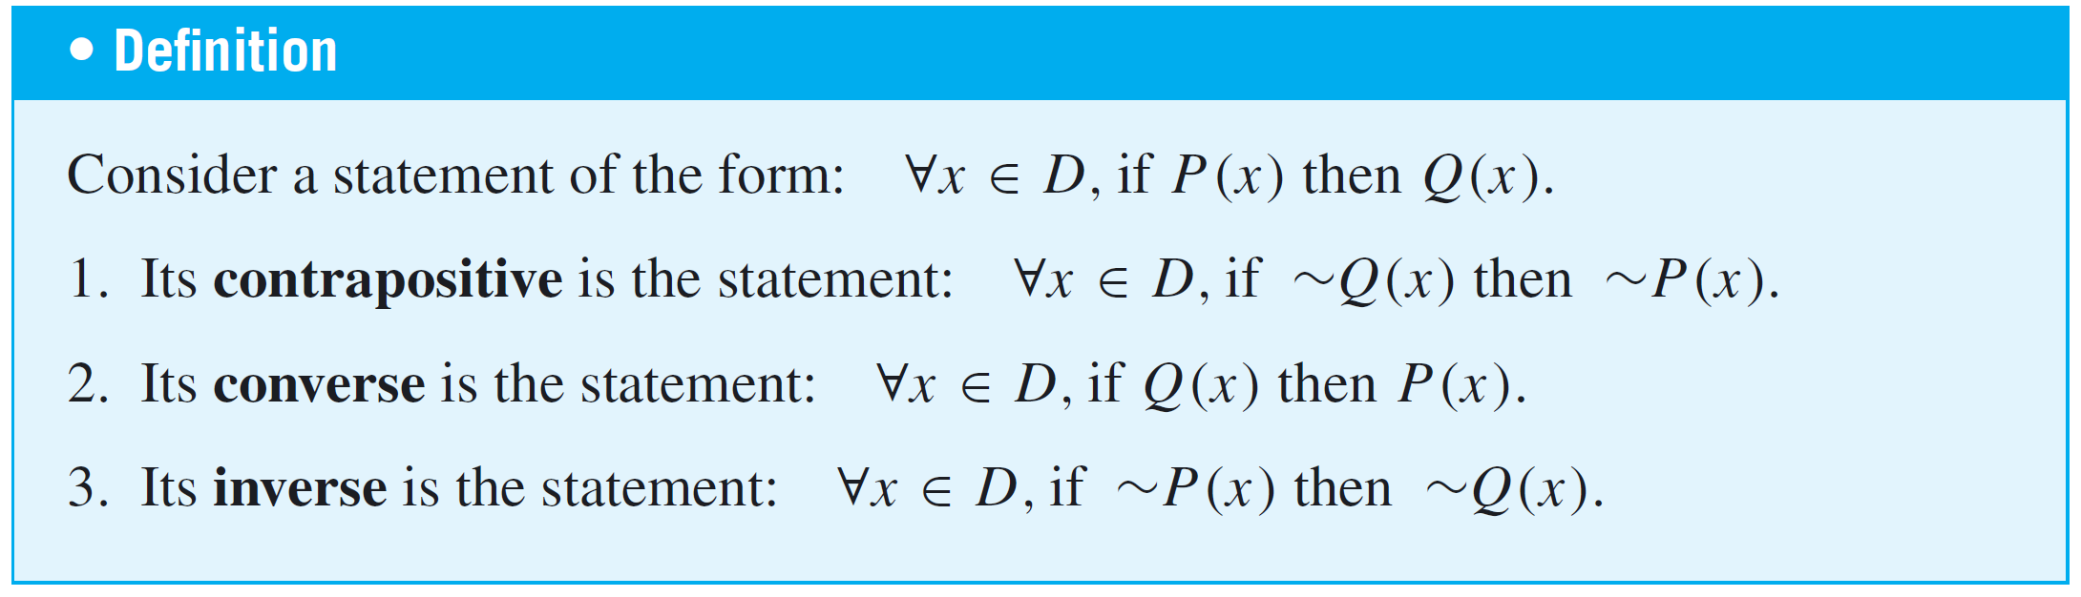
Variants of Universal Conditional Statements
We have known that a conditional statement has a contrapositive, a converse, and an inverse.
The definitions of these terms can be extended to universal conditional statements.

Slide 26
Example 5 – Contrapositive, Converse, and Inverse of a Universal Conditional Statement
Write a formal and an informal contrapositive, converse, and inverse for the following statement:
If a real number is greater than 2, then its square is greater than 4.
Solution:
The formal version of this statement is
∀x ∈ R, if x > 2 then x² > 4.

Slide 27
Example 5 – Solution
cont’d
Contrapositive: ∀x ∈ R, if x² ≤ 4 then x ≤ 2.
Or: If the square of a real number is less
than or equal to 4, then the number is less
than or equal to 2.
Converse: ∀x ∈ R, if x² > 4 then x > 2.
Or: If the square of a real number is greater
than 4, then the number is greater than 2.
Inverse: ∀x ∈ R, if x ≤ 2 then x² ≤ 4.
Or: If a real number is less than or equal to
2, then the square of the number is less
than or equal to 4.

Slide 28
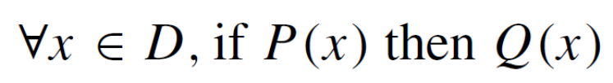
Variants of Universal Conditional Statements
Let P(x) and Q(x) be any predicates, let D be the domain of x, and consider the statement
and its contrapositive
Any particular x in D that makes “if P(x) then Q(x)” true also makes “if ~Q(x) then ~P(x)” true (by the logical equivalence between p → q and ~q → ~p).

Slide 29
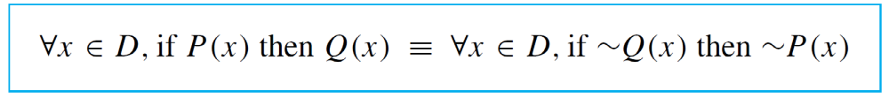
Variants of Universal Conditional Statements
It follows that the sentence “If P(x) then Q(x)” is true for all x in D if, and only if, the sentence “If ~Q(x) then ~P(x)” is true for all x in D.
Thus we write the following and say that a universal conditional statement is logically equivalent to its contrapositive:

Slide 30

Variants of Universal Conditional Statements
In Example 3.2.5 we noted that the statement
∀x ∈ R, if x > 2 then x² > 4
has the converse
∀x ∈ R, if x² > 4 then x > 2.
Observe that the statement is true whereas its converse is false (since, for instance, (−3)² = 9 > 4 but −3 2).

Slide 31
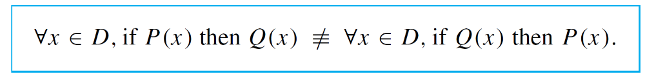
Variants of Universal Conditional Statements
This shows that a universal conditional statement may have a different truth value from its converse.
Hence a universal conditional statement is not logically equivalent to its converse.
This is written in symbols as follows:

Slide 32
Necessary and Sufficient Conditions, Only If

Slide 33
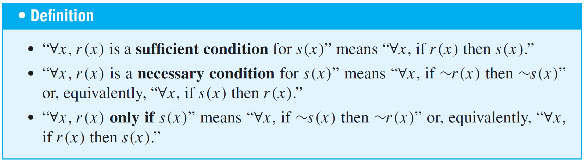
Necessary and Sufficient Conditions, Only If
The definitions of necessary, sufficient, and only if can also be extended to apply to universal conditional statements.

Slide 34
Example 6 – Necessary and Sufficient Conditions
Rewrite the following statements as quantified conditional statements. Do not use the word necessary or sufficient.
a. Squareness is a sufficient condition for rectangularity.
b. Being at least 35 years old is a necessary condition for
being President of the United States.
Solution:
a. A formal version of the statement is
∀x, if x is a square, then x is a rectangle.

Slide 35
Example 6 – Solution
cont’d
Or, in informal language:
If a figure is a square, then it is a rectangle.
b. Using formal language, you could write the answer as
∀ people x, if x is younger than 35, then x
cannot be President of the United States.
Or, by the equivalence between a statement and its contrapositive:
∀ people x, if x is President of the United States,
then x is at least 35 years old.

